Slide 1
Microsoft MakeCode from C++ to TypeScript and Blockly (and back)
C++ Users Group Meeting
April 2018
Notes:
Title
Microsoft MakeCode: from C++ to TypeScript and Blockly (and Back)
Speaker
Thomas Ball, Principal Researcher, Microsoft Research
http://research.microsoft.com/~tball/
Abstract
Across the globe, it is now commonplace for educators to engage in the making (design and development) of embedded systems in the classroom to motivate and excite their students. This new domain brings its own set of unique requirements. Historically, embedded systems development requires knowledge of languages such as C and C++, local installation of compilation toolchains, device drivers and applications. For students and educators, these requirements introduce unnecessary barriers and restrictions.
Over the last two years, Microsoft has invested in a new web-based programming platform for embedded systems in education, called Microsoft MakeCode (www.makecode.com), in partnership with Lancaster University, who created the C++ Component-oriented Device Abstraction Layer (https://github.com/lancaster-university/codal). In this talk, I’ll describe the design principles behind MakeCode and CODAL and our experience with it to date. In particular, I’ll describe how our stack exposes C++ in the browser via TypeScript and Blockly programming APIs, with an in-browser compiler tool chain that produces executable files without the need for a C++ compiler in the core end-user experience. MakeCode is open source at http://github.com/microsoft/pxt
Bio
Thomas (Tom) Ball is a principal researcher and manager at Microsoft Research. In 1999, He initiated the influential SLAM software model-checking project with Sriram Rajamani, which led to the creation of the Static Driver Verifier tool for finding defects in Windows device drivers. Tom is a 2011 ACM Fellow for ‘contributions to software analysis and defect detection’. As a manager, he has nurtured research areas such as automated theorem proving, program testing/verification and empirical software engineering. His current focus is the Microsoft Makecode platform for programming with physical computers.

Slide 2


Microsoft MakeCode Hands-on Computing for every student
Just works always, everywhere
Physical computing a more inclusive approach to CS education
Path to real-world skills
Extensible platform for partners

Slide 3
Microsoft MakeCode Objectives
Usage – Increased diversity and number of students engaged/interested in computing and technology
Brand – Microsoft recognized as an innovator in computing education
Ecosystem – Democratizing access to the world of intelligent edge devices and enabling a thriving partner ecosystem

Slide 4
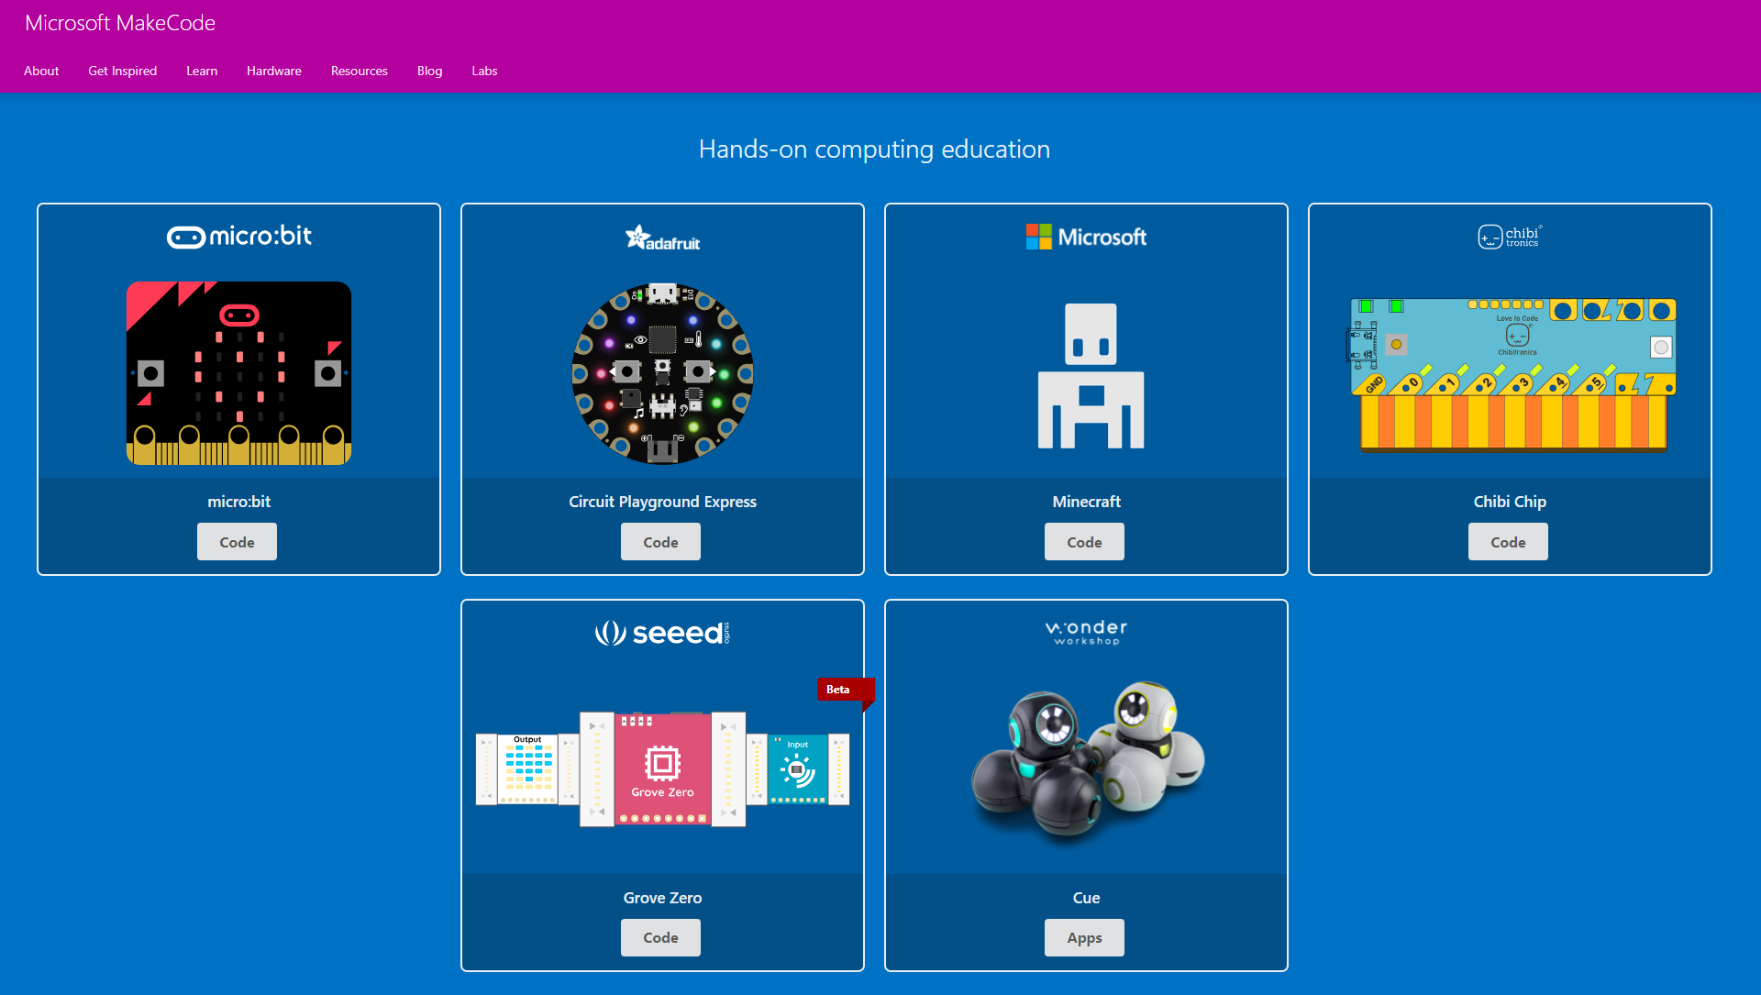
www.makecode.com
Notes:
Demo of adafruit

Slide 5
Principles
Simple to make and code with physical computers
Blocks -> JavaScript (via TypeScript)
Go to where teachers/students are today:
ChromeBooks
iOS, Android (phones, tablets)
Windows, MacOS, Linux, …
Progression to:
wider world of programming languages
richer physical computing ecosystem (IoT, …)
the cloud, data science, machine learning, …

Slide 6
Innovations
Web app for end-to-end experience
no install or need for C/C++ compiler for end-user
in-browser compilation to binary
TypeScript as core language
API mapping: up to Blockly and down to C++
coverage of OO concepts
Runtime abstractions
Events, message bus and co-routines
support concurrent, reactive programming
Blockly
TypeScript
C++
Notes:
web based editor: nothing to install
cross platform: works in most modern browsers from tiny phone to giant touch screens
compilation in the browser: the compiler runs in your browser, it's fast and works offline
blocks + JavaScript: drag and drop blocks or type JavaScript, MakeCode let's you go back and forth between the two.
works offline: once you've loaded the editor, it stays cached in your browser.
event based runtime: easily respond to button clicks, shake gestures and more

Slide 7
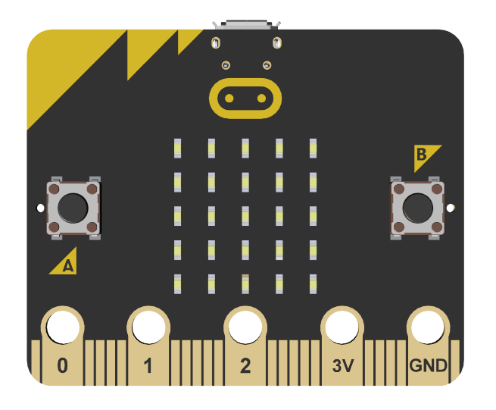
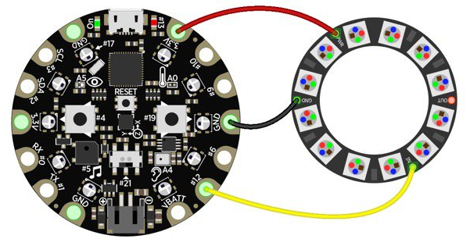
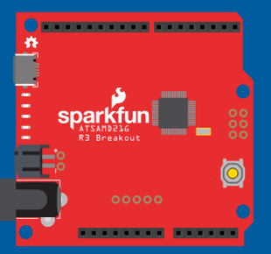
MakeCode and CODAL
makecode.microbit.org
maker.makecode.com
Web sites
makecode.adafruit.com
Blockly and JavaScript Editors
(Static) TypeScript
Web app
Simulator
Compiler
STS and C++ CODAL Runtime
Devices

Slide 8
Editors
Simulator
Web App
Blockly
JavaScript
TypeScript
Metadata generation
Browser compilation
Monaco
Static TypeScript
IR
Assembly
user
binary
TypeScript
Device
runtime
Linker
Static
TypeScript
runtime
binary
cached copy
Shim generation
final binary
C++
runtime
binary
compile
Cloud compilation
decompile
link

Slide 9
TypeScript
Gradually typed superset of JavaScript
Compiles to JavaScript
Supports ECMAScript 2015 and latest language features
Types enable productivity tools
intellisense, navigation, refactoring
http://www.typescriptlang.org/

Slide 10
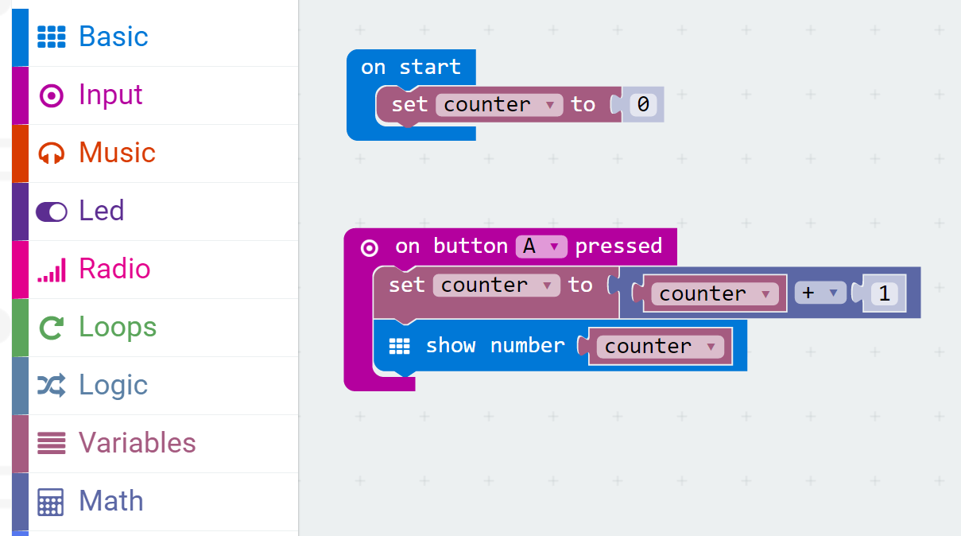
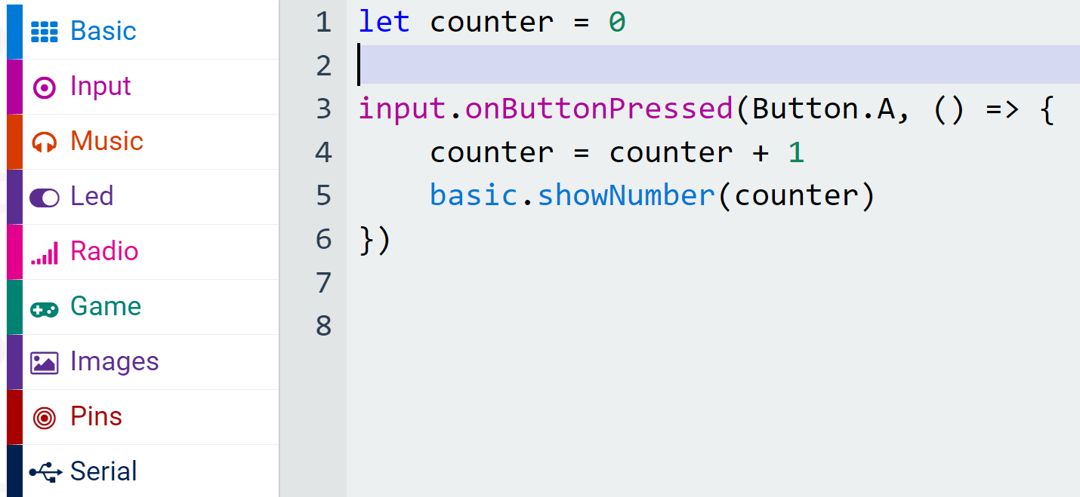
Blocks and TypeScript
Blockly
TypeScript
Categories
Namespaces

Slide 11
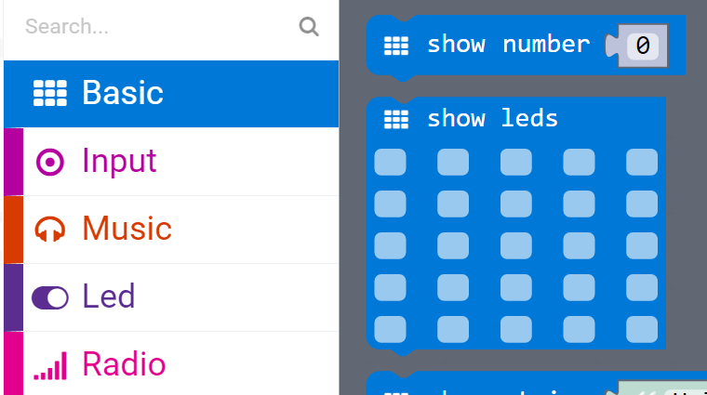
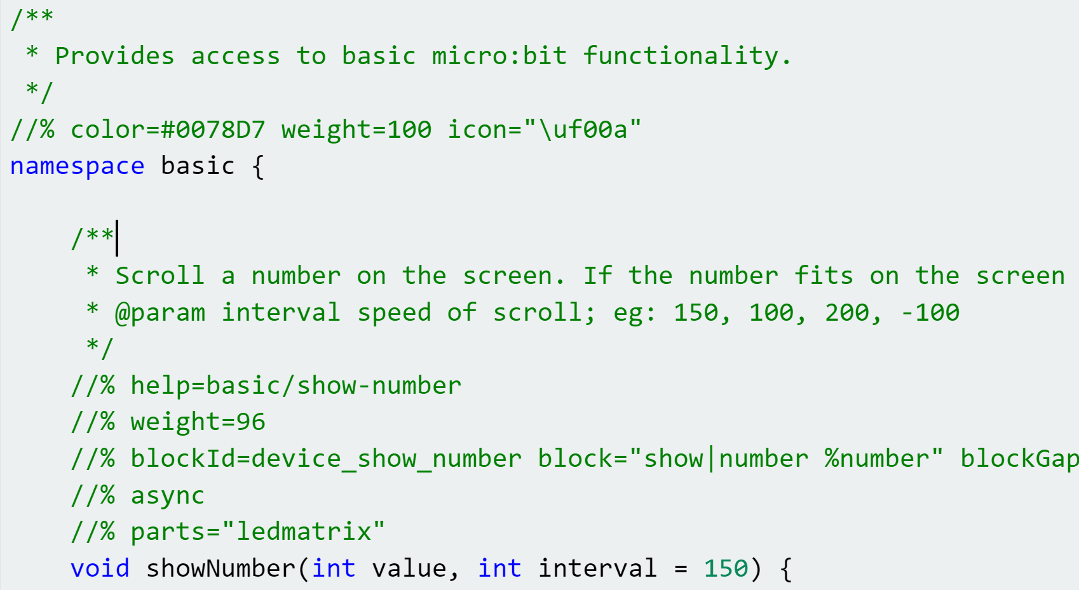
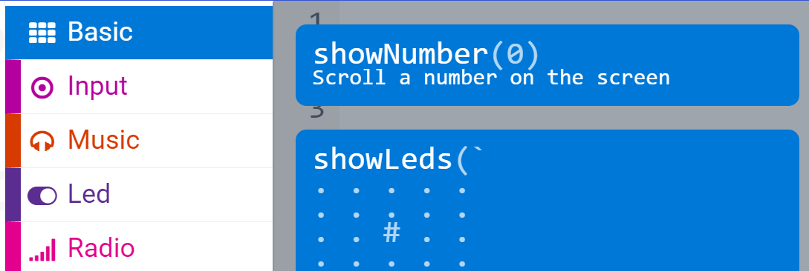
API Binding (1)
Blockly
C++
TypeScript

Slide 12
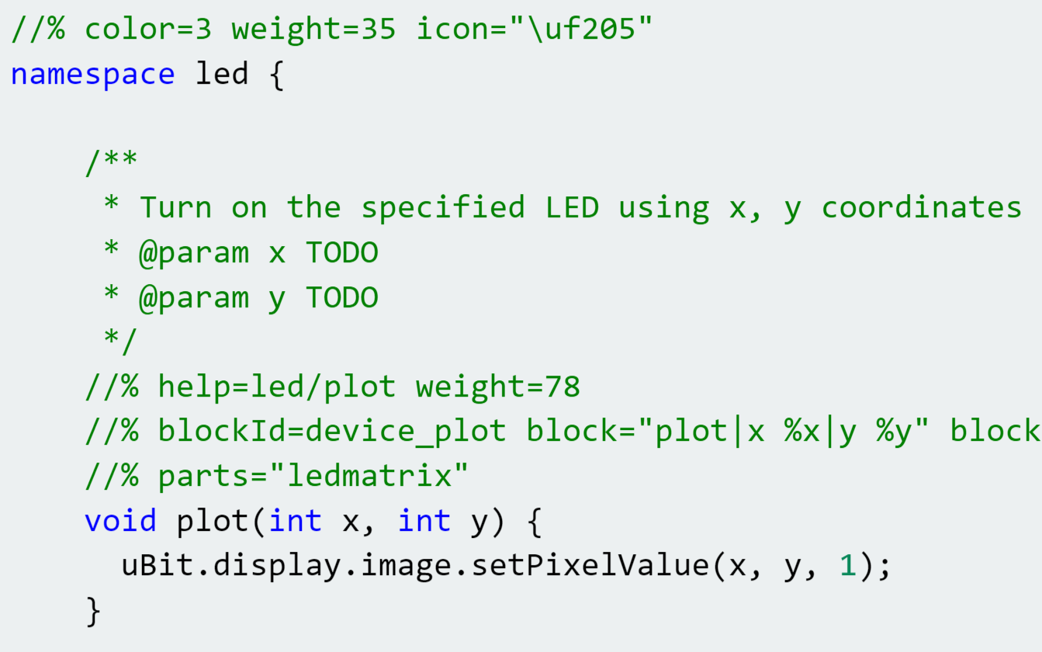
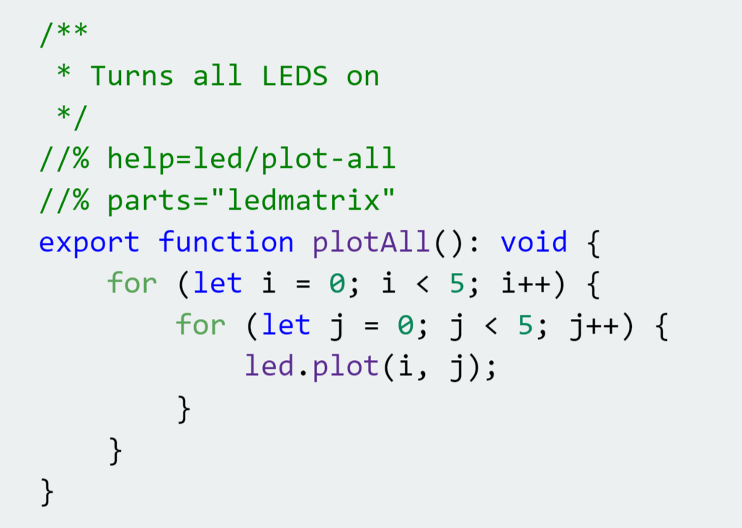
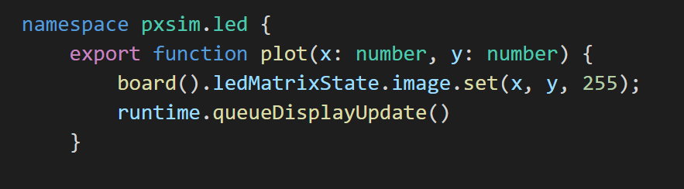
API Binding (2)
C++ wrapper to micro:bit runtime
TypeScript runtime extension
TypeScript simulator implementation

Slide 13
CODAL, MakeCode and C++
CODAL: Component-oriented Device Abstraction Layer
Lancaster University: Joe Finney and James Devine
MakeCode, bottom-up
http://github.com/microsoft/pxt-common-packages
glue between CODAL and MakeCode
provides standard TypeScript/Blockly APIs for common device features
http://github.com/microsoft/pxt-adafruit
specifies full Adafruit target, using and overriding common packages
fully defines the web app
TypeScript Declaration files (shim files)
Compiling C++ into device runtime (generation of shim files)
Extending the device runtime with Static TypeScript

Slide 14
codal-core
Blockly,
Typescript, Monaco
pxt
uses
references
extends,
implements
codal-atmega328p
pxt-common-packages
references
uses
codal-arduino-uno
uses
codal
(build shell)
uses
pxt-target
extends,
implements
codal-samd21
selects from
uses
codal-circuit-playground
MakeCode web app
Notes:
https://github.com/lancaster-university/codal-adafruit-cplay
Installing dependencies...
codal-core is already installed
mbed-classic is already installed
codal-samd21 is already installed
codal-mbed is already installed
Using library: codal-circuit-playground
Using library: codal-core
Using library: mbed-classic
Using library: codal-samd21
Using library: codal-mbed
-- Configuring done

Slide 15
CODAL repos
Build: https://github.com/lancaster-university/codal
Base: https://github.com/lancaster-university/codal-core
https://github.com/lancaster-university/codal-mbed
https://github.com/lancaster-university/codal-samd21
https://github.com/lancaster-university/codal-circuit-playground
https://github.com/lancaster-university/codal-atmega328p
https://github.com/lancaster-university/codal-arduino-uno
…

Slide 16
https://github.com/lancaster-university/codal-core
Message Bus
Device Drivers
Non-preemptive
Scheduler
Managed Types

Slide 17
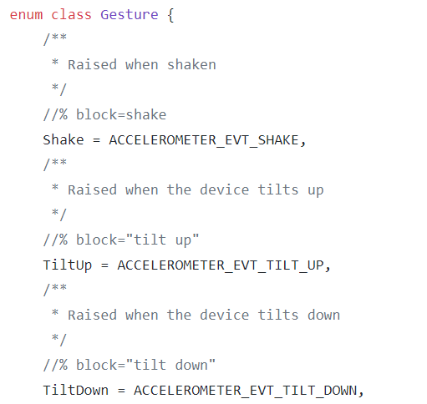
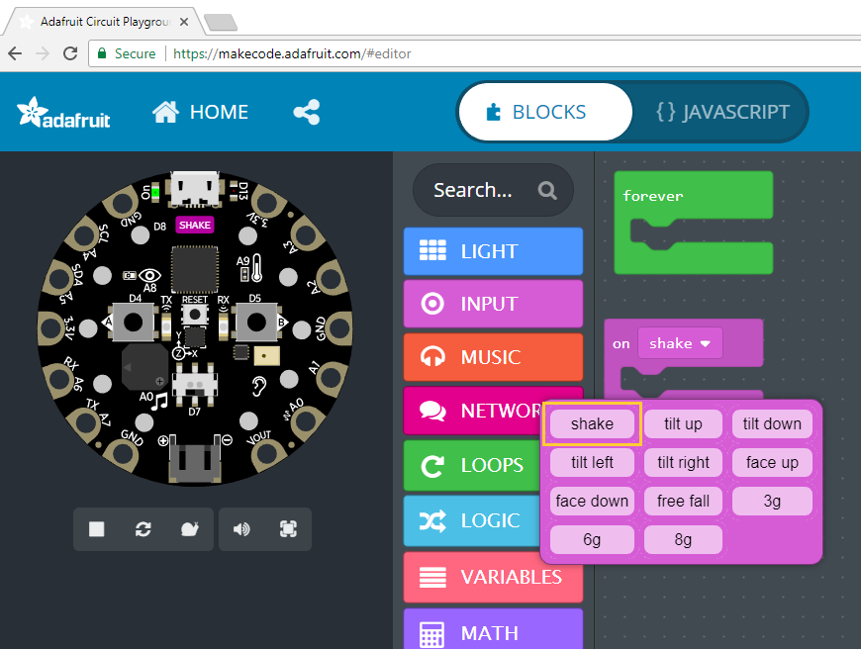
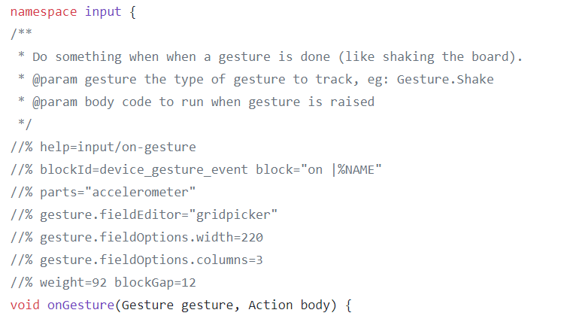
https://github.com/Microsoft/pxt-common-packages/blob/master/libs/accelerometer/accelerometer.cpp

Slide 18
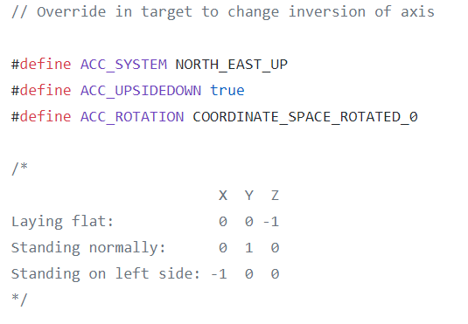
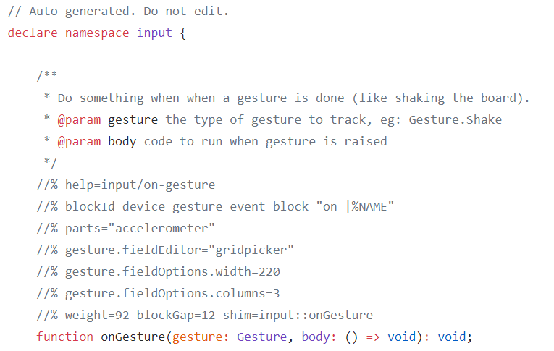
Target specific override and shim file
https://github.com/Microsoft/pxt-adafruit/blob/master/libs/accelerometer/axis.h
https://github.com/Microsoft/pxt-adafruit/blob/master/libs/accelerometer/shims.d.ts

Slide 19
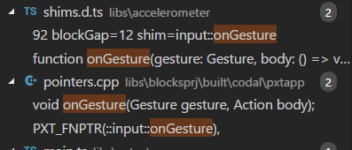
Compiling C++ for MakeCode
Preprocessing of C++
https://makecode.com/simshim
Determines which C++ entities will be visible/exported via TypeScript Declaration File
1-1 mappings between most C++ and TypeScript entities
bool, number, string, enums
lambdas, functions
namespaces
collections
Invoke C++ to generate runtime binary
With exported points
Incorporated into web app

Slide 20
Static TypeScript
Considerations
Compile for low-memory footprint
Link against pre-compiled C++ runtime
All types known at compile time, no runtime checks
TypeScript without the Any type and “bad parts”
a subset of TypeScript, with some type substitutions (number -> int32)
excludes
the eval function, the with statement, the typeof expression
type assertions, var statement
access to prototype property and computed properties
access to the “this” pointer outside of a class

Slide 21
What’s Left in Static TypeScript?
standard control-flow statements
let and const: lexically-scoped variable declarations
functions (nested) and lambdas
classes with instance fields, methods and constructors
generic classes, methods, and functions for code reuse
namespaces

Slide 22
Extending with Static TypeScript

Slide 23
MakeCode GitHub repos
Framework and support
https://github.com/Microsoft/pxt
https://github.com/Microsoft/pxt-blockly
https://github.com/Microsoft/pxt-monaco-typescript
https://github.com/Microsoft/pxt-common-packages (CODAL-specific)
Targets
https://github.com/Microsoft/pxt-adafruit
https://github.com/Microsoft/pxt-chibitronics
https://github.com/Microsoft/pxt-microbit
https://github.com/Microsoft/pxt-maker

Slide 24
MakeCode GitHub Packages
Primarily for the micro:bit
https://github.com/Microsoft/pxt-neopixel
https://github.com/Microsoft/pxt-max6675
https://github.com/Microsoft/pxt-sonar
https://github.com/Microsoft/pxt-bluetooth-midi
https://github.com/Microsoft/pxt-gestures
https://github.com/Microsoft/pxt-microturtle

Slide 25
The Web
(browser)
Plentiful RAM
World of great frameworks
for beginning programming
(Blockly)
Web App
JavaScript
Single-threaded
Static TypeScript
our contribution
bringing the worlds of
Web and MCU together
MakeCode = integration/entry point
Languages
Compiler
Runtime
CODAL
Reactive/
concurrent
C/C++
Full bare-metal binary
The microcontroller
(MCU)
Little RAM
World of the pro IDE
(Eclipse, VS, VS Code)

